Slide 1
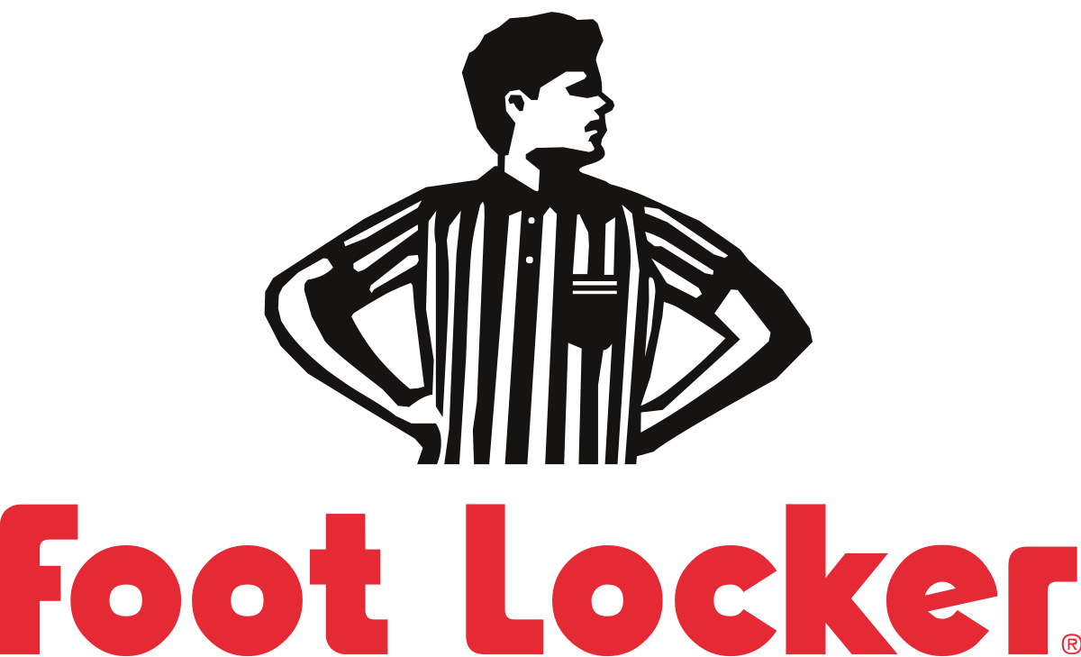
Foot Locker
& its Supply Chain
Sophie Birk, Yinuo He, Brandon Ying, Shagun Modi, Shasti Santhayapalayam Venkittaswamy, Shiv Agarwal

Slide 2
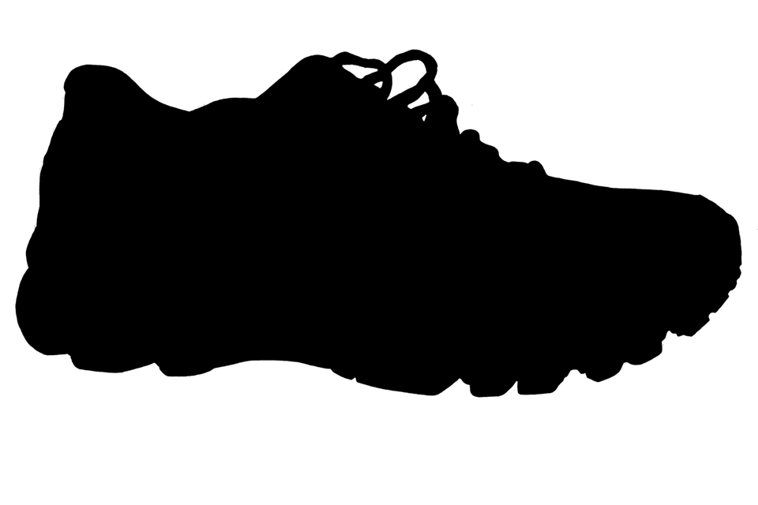
Agenda:
1
Introduction & Background
4
Risks & Challenges
2
Competitor
Analysis
5
Strategic Developments
3
The Supply Chain
6
Strategy Recommendations & Final Words

Slide 3
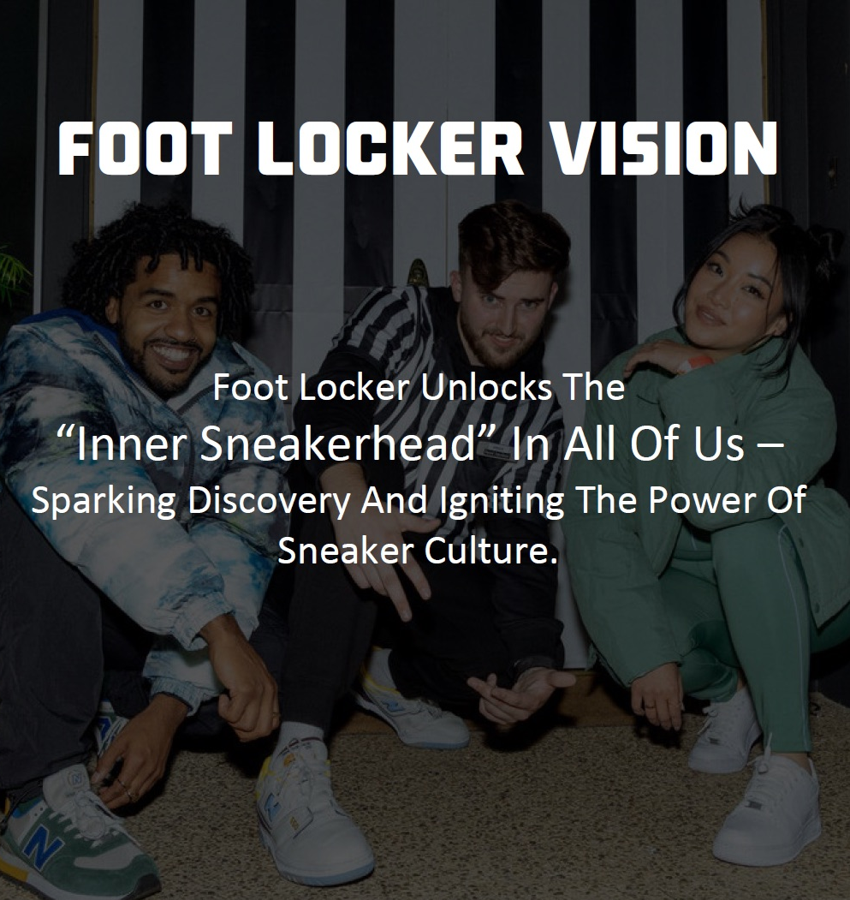
1
Introduction & Background

Slide 4
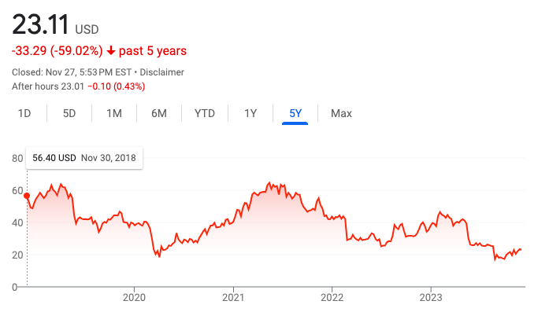
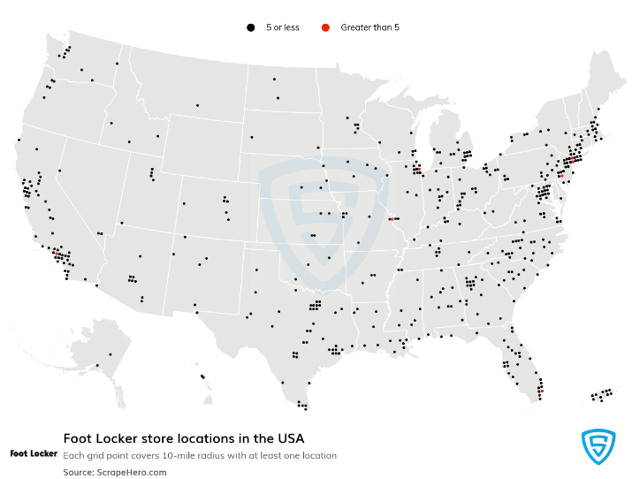
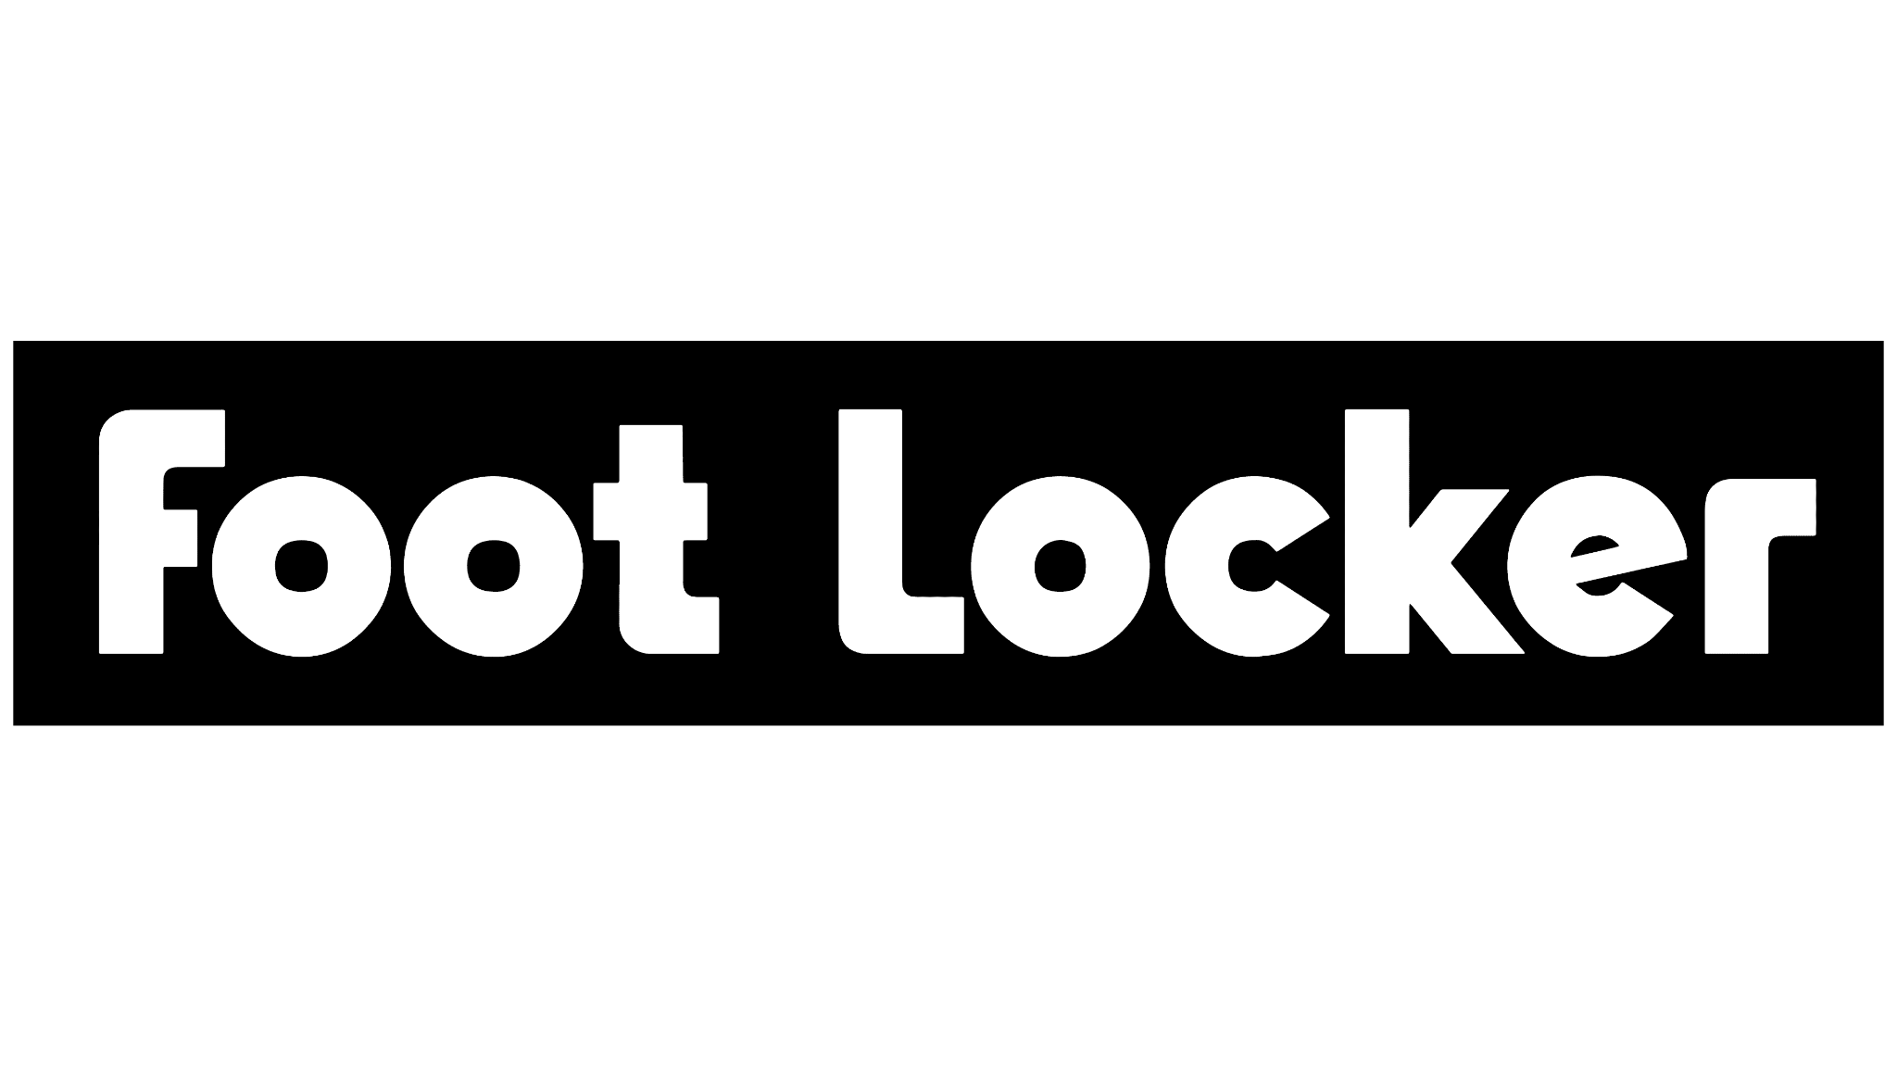

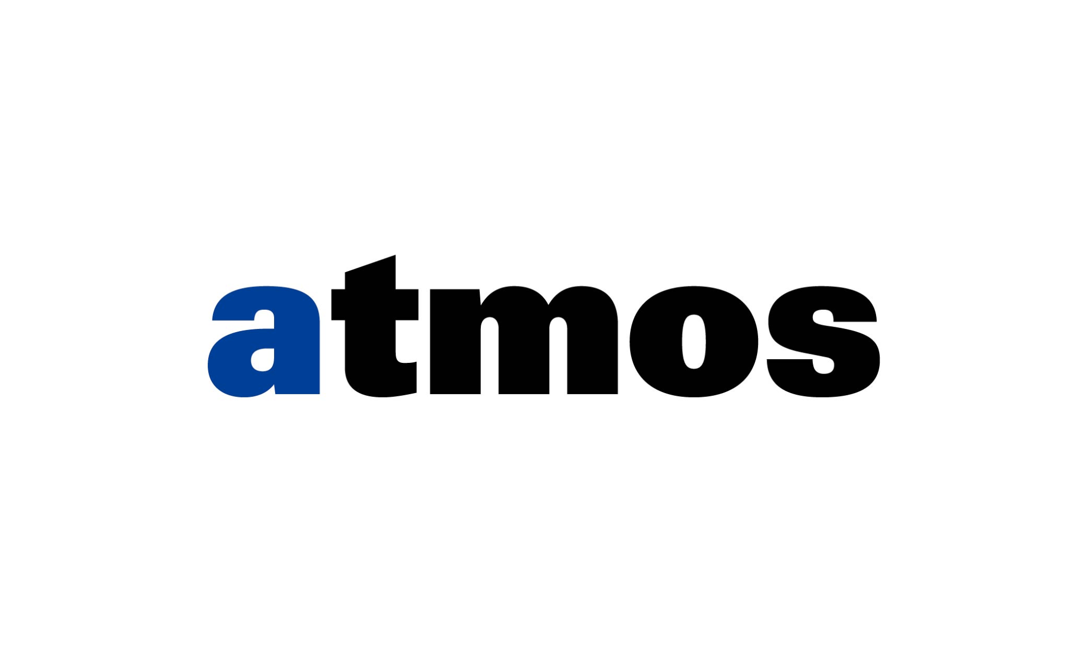
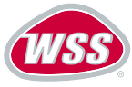

Introduction & Background
WHAT ? - American sportswear and footwear retailer
WHERE ? - HEADQUARTERS: New York City
HOW MANY ? 2,600 retail stores in 26 countries

Slide 5
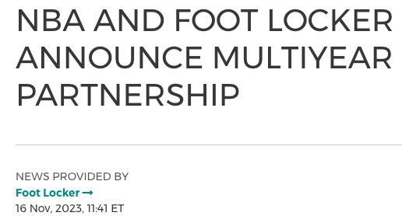
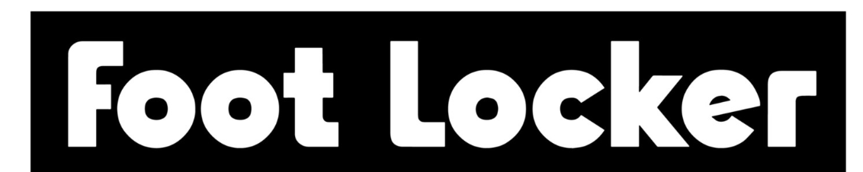
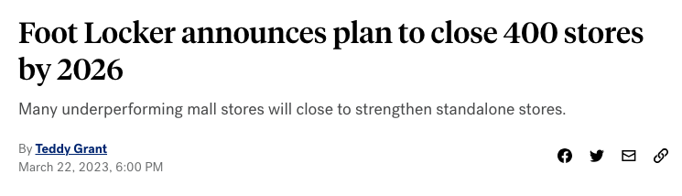
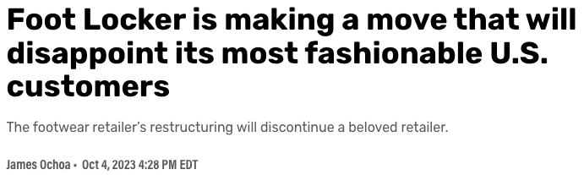
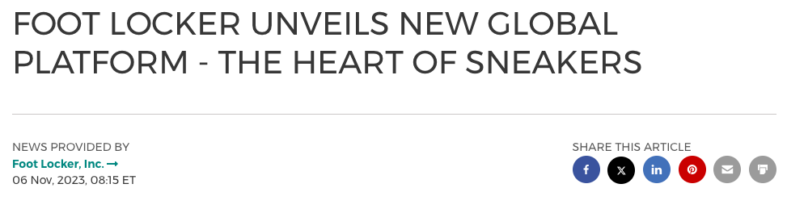
SUPPLY CHAIN DILEMMAS ?
Notes:
Foot Locker plans to close many of its non-performing Stores in the malls, and would shift their focus to stand-alone stores with newer, experimental concepts
Foot Locker has made a partnership with NBA to the official marketing partner of the league in US.
Atmos announced that it will be shuttering its operations in the United States in an effort to concentrate its efforts onto operations in Japan and the rest of Asia
The Heart of Sneakers is an ongoing platform that will weave into all of the brand's campaigns, online and in-store experiences, community-rooted events, and more moving forward.

Slide 6
2
Competitor
Analysis

Slide 7
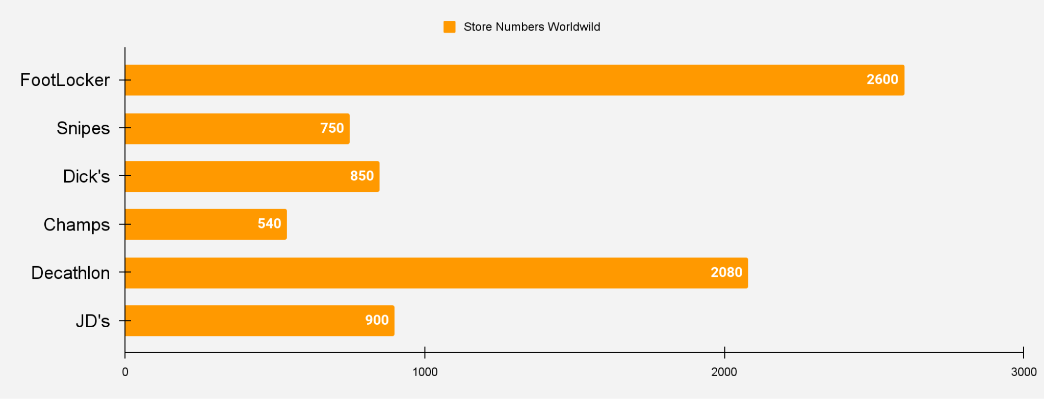
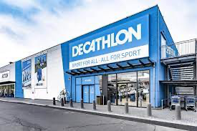
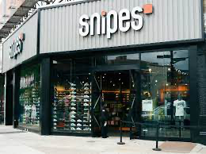
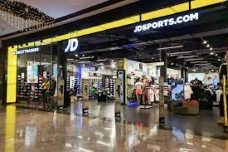
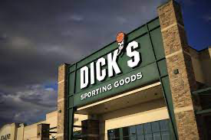
Competitors
Main Competitors
- with same business model
Sportswear Retailers with Combinations of Different Brands
JD Sports
Snipes
Dick’s
Decathlon

Slide 8
Strengths & Weaknesses with Competitors
Strengths
Weaknesses
Global business with a large number of stores.
Strong relationships have been established with brands
Maintains a diverse product portfolio
Streamlining operations and building a reliable supply chain
Products are heavily reliant on external brands.
The rise of online retailing poses a threat to traditional retailing.
Vulnerability to the economy

Slide 9
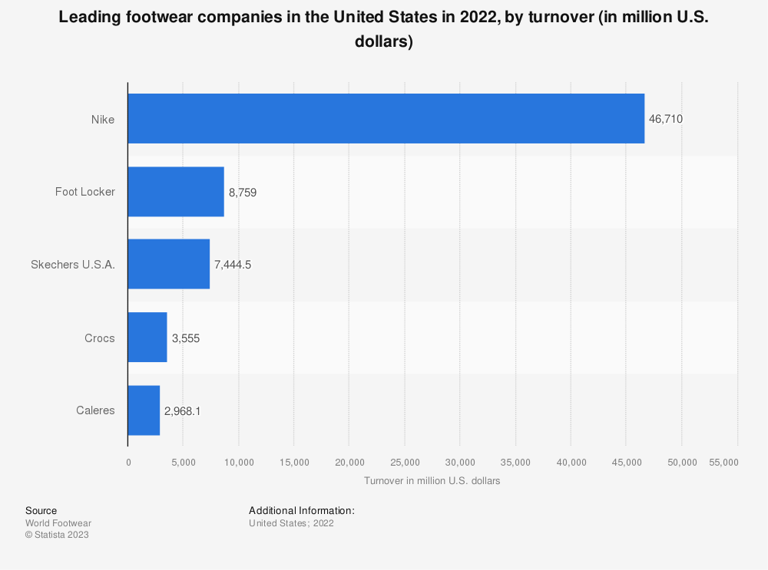
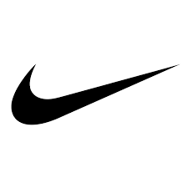
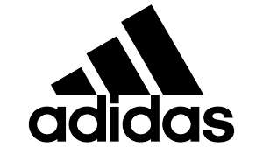
Competitors
Other Competitors
-with different business model
Are They Really Competitors? Or Only Competitors?
Foot Locker is a well known and large retailer. It leverages its connections with suppliers like Nike, Adidas, PUMA, and Reebok.
“ Diversifying our Brand Mix. Non-Nike sales in our core banners grew about 10% in 2022 as we continue to optimize our assortment to serve consumers’ appetite for choice. As we diversify our portfolio across more brands, we are also revitalizing our relationship with Nike to return to growth beginning in 2024, further strengthening our offering for consumers. “
–Foot Locker 2022 Annual Report
Designing, manufacturing and marketing of own-brand sports products
Nike
Adidas
Crocs
Skechers

Slide 10
Competitors But Suppliers
Biggest Supplier - Nike
Nike is Foot Locker's primary supplier of a wide range of athletic shoes, apparel and accessories.
Key Strategy Relationship
Product Offering: Nike products, including iconic athletic shoes such as the Air Max and Air Jordan lines, are an integral part of Foot Locker's product offering.
Distribution partner: Foot Locker is a key distribution channel for Nike, providing an extensive retail network where consumers can purchase Nike products.
Promotions and Discounts: Actively promotes products through marketing campaigns and in-store displays.
Deeper Level of Cooperation: Available in the out of stock products at Nike.

Slide 11
3
Foot Locker’s Supply Chain Strategies
Notes:
SOPHIE

Slide 12
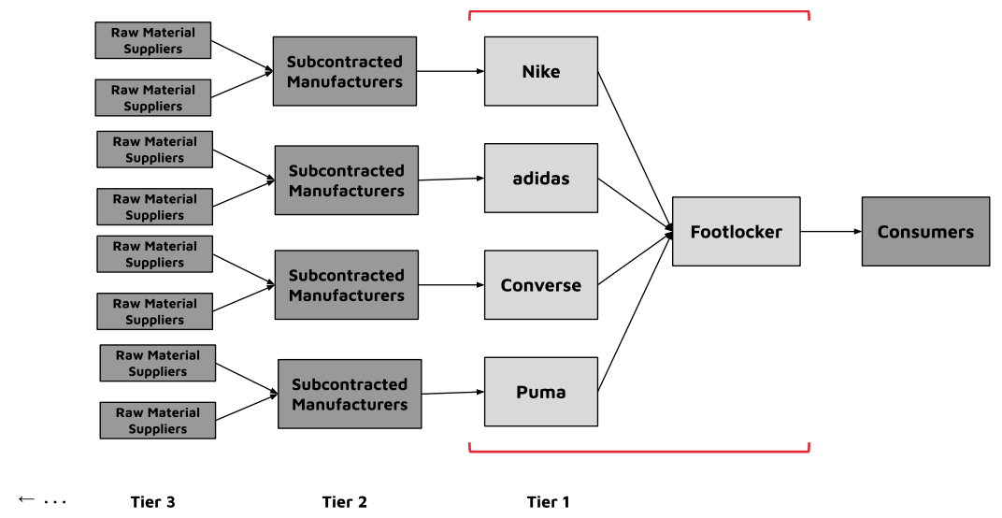
Foot Locker’s Procurement/Supply Strategy:
To offer a large selection of brands for customers to choose from, Foot Locker purchases finished goods (footwear) from several suppliers (retailers).
Notes:
SOPHIE

Slide 13
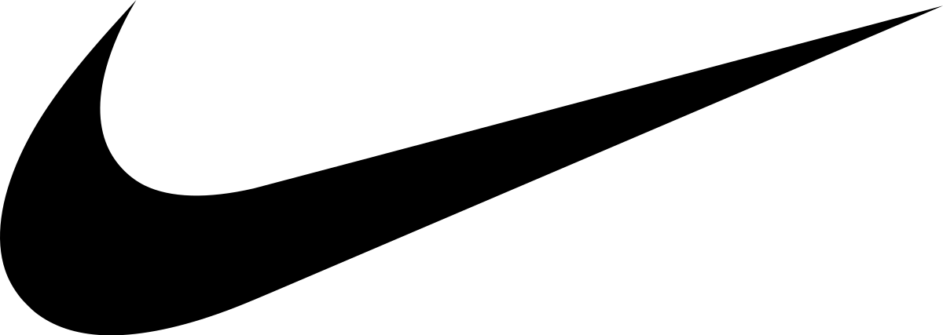
Foot Locker’s Procurement/Supply Strategy:
Pros:
Brand recognition
Broad assortment
Purchase discounts
‘Special’ product availability
Cons:
Supplier dependence
Breadth, but not depth
Competitor-supplier tension
Nike: A Strategic Partner
Biggest supplier
Nike drives profitability
~70% of sales
Supply base change
55% of purchases in 2023 vs. 75% in 2020
Nike expands own DTC
Foot Locker expands brand offering
Can Foot Locker still survive without its #1 supplier, Nike?
Notes:
SOPHIE

Slide 14
Foot Locker’s Inventory Management Strategy:
Capital Investment for Inventory Capabilities
To increase by 50% over next 4 years
Invested in advanced tracking system with RFID tags for increased inventory visibility
Tracks product across DC’s, stores & online in real time
Handheld devices for store associates
Pros:
Visibility over thousands of SKUs
Customers/employees are aware of product availability
Perpetual review system
Omnichannel focus
Cons:
Big investment
Increased visibility does not guarantee sales
Notes:
SOPHIE
https://www.modernretail.co/operations/foot-lockers-ongoing-inventory-challenges-drove-a-sales-dip/

Slide 15
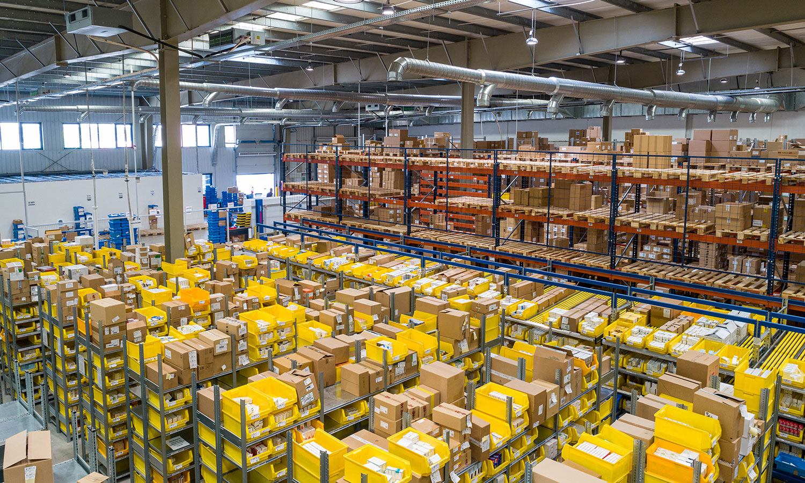
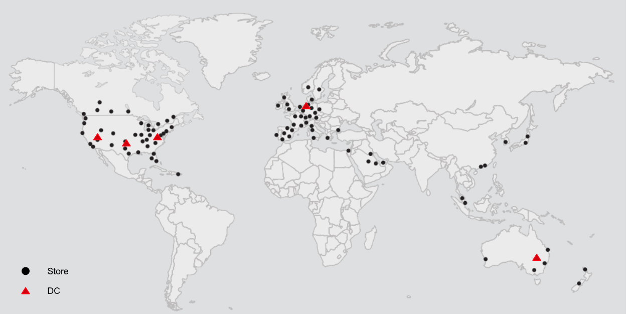
Foot Locker’s Distribution Strategy:
Global Distribution Capabilities
Operates 5 distribution centers around the world
Three distribution centers, serving the US, Australia, and Europe
2 centralized distribution centers → 3-hub regional distribution center
95% of customers and Foot Locker stores are within two days of the company’s product.
620 Foot Locker and Champs Sports stores outside the US
377 in Europe, 168 in Canada and 75 in Australia
Approximately 19% of sales generated in international markets last year
Lead time of 3-5 days for customers, expedited same-day shipping offered
Notes:
https://www.sec.gov/Archives/edgar/data/850209/000085020921000003/fl-20210130x10k.htm#Item7ManagementsDiscussionandAnalysisofF
https://help.footlocker.com/hc/en-us/articles/360034159954-What-are-your-shipping-prices-and-time-frames-
https://investors.footlocker-inc.com/static-files/f9c9a6be-8766-4963-9fc0-98fa12ffa995
https://marketrealist.com/2016/06/analyzing-cogs-foot-lockers-supply-chain/
https://www.footlocker-inc.com/content/dam/flincfoundation/footlockerinc_documents/annual-reports/Foot%20Locker%202022%20Annual%20Report%20FINAL%20FINAL%20POST.pdf
https://www.ajot.com/insights/full/ai-foot-locker-to-make-strides-with-mini-hubs-ceo-says-in-kicking-off-rila-conference
Global diversification is a vital component of the Company's strategic positioning. This diversification is unique in the athletic footwear and apparel retail industry and provides many distinct advantages. Foot Locker, Inc. has established a strong presence in several global markets within the United States, Canada, Europe and Australia. Its infrastructures within these regions are sufficient to support the Company's exciting new store growth plans for the next several years. The Company currently operates 620 Foot Locker and Champs Sports stores outside the United States, with 377 in Europe, 168 in Canada and 75 in Australia. Last year, approximately 19 percent of the Company's sales were generated in international markets. In addition to providing significant growth opportunities, global diversification can cushion the adverse effects from one weak economy with the positive impact from a more vibrant economy in another region.

Slide 16
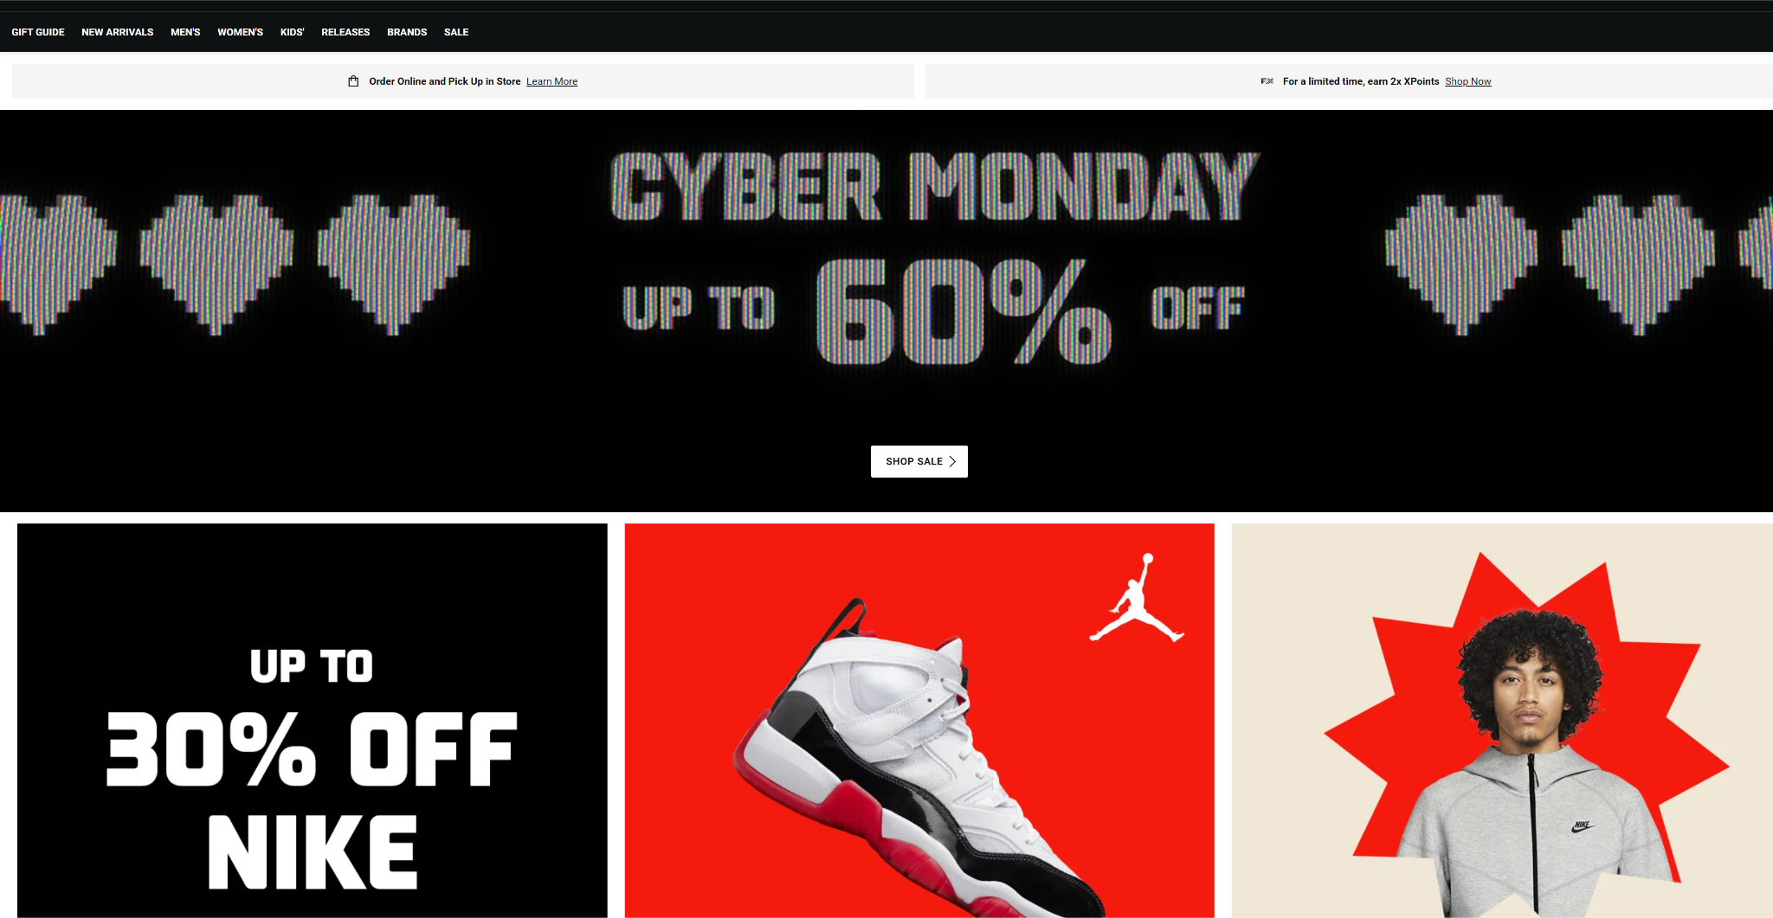
Foot Locker’s Distribution Strategy:
Online Retail Distribution
“Lace Up” priorities:
Expanding sneaker culture,
refreshing its portfolio,
deepening relationships with customers, and
improving its omnichannel operations.
Increase its average annual capital expenditure run rate by more than $50 million over the next few years, focusing on tech investment
“Over the last decade, we have invested at a level below the industry benchmark,” Chief Operations Officer Elliott Rodgers said of the retailer’s tech investment.
In 2022, over 80% of Foot Locker traffic came through mobile
Tech investment is now at 3% of sales, and capital expenditure in the area will increase by 50% over the next four years.
Buy Online, Pickup in Store
Notes:
https://www.footlocker-inc.com/content/dam/flincfoundation/footlockerinc_documents/vms/europe/2022/Section%2002.%20-%20Purchase%20Orders.pdf
https://www.footlocker.com/
https://www.retaildive.com/news/foot-locker-relaunch-mobile-app-website-revamp-twenty-five-billion-digital-sales/646194/
Foot Locker is updating its website with personalized product recommendations, improved search and navigation, better product visuals and in-depth ratings and reviews, according to Peter Scaturro, senior vice president of strategic planning and growth. The retailer will also relaunch its mobile app to “drive energy, commerce and connectivity across our customer base.”
“In 2022, over 80% of our traffic came through mobile,” Scaturro said. “So our customer is telling us how and where they want to engage.

Slide 17
4
Foot Locker’s Risks & Challenges
Notes:
SOPHIE

Slide 18
Supply Chain Risks
Dependence on Few Suppliers
Inventory Management
Financial Stability
Heavily reliant on a small number of suppliers
As of 2022 Nike accounts for 65% of its merchandise purchases
This exposes Foot Locker to potential supply chain disruptions
Foot Locker faces challenges in managing inventory levels, evident in a recent 11% increase.
Potential risks: Excess inventory, markdowns, impacting profitability adversely.
Foot Locker's financial stability linked to the reputation and health of Nike, a primary supplier.
Concerns over potential financial implications due to surplus stock.

Slide 19
Risk Mitigation Strategies
1
2
3
Supplier Diversification
Supply Chain Technology
Collaborative Relationships
Decreasing dependency on Nike by broadening supplier base.
Acquiring and investing in new brands like Atmos and WSS to diversify offerings.
Partnerships with emerging brands (Stadium Goods, GOAT) for trend exposure and wider customer reach.
Enhanced Foot Locker's efficiency, cost reduction, and customer experience.
Utilization of data analytics predicted high demand for the Air Jordan 1 Retro High OG "University Blue" sneaker.
Foot Locker nurtures strong, collaborative ties with suppliers.
Emphasis on communication, innovation, and resilience.
Ensures stable, quality product flow, meeting customer needs.
Contributes significantly to overall company success.

Slide 20
5
Foot Locker’s Strategic
Developments
Notes:
SOPHIE

Slide 21
Strategic Developments
Diversification of Brand Mix
Infrastructure Investment
Off Mall Expansion
Enhancing Customer Relationship
Actively diversifying brand mix
Optimizing product assortment
Strengthening relationships with key brands
Double sales of non-Nike brands, such as Hoka On, and Crocs by 2026
Investing $40+ million in new distribution center
Located in Reno, Nevada
Aiming to enhance distribution capabilities and reduce shipping times by over 50% in the West Coast region
Strategic shift to off-mall locations
Aligning with changing shopping patterns
Introducing Power and Community formats
Enhancing in-store shopping experience
Focusing on loyalty programs to attract broader range of customers
Leveraging Customer data for enhanced personalisation

Slide 22
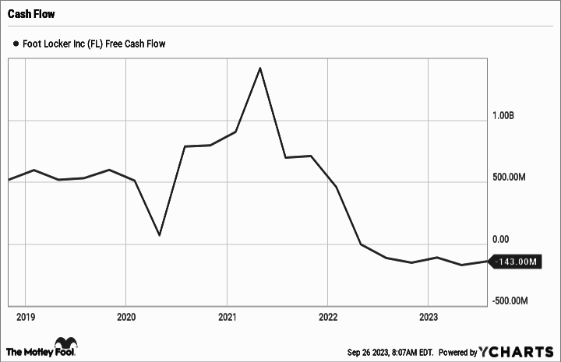
Recommendations
Long Term
Short Term
Increasing Online Presence
Reduction in On-hand Inventory
Take advantage of their huge retail channel to fulfill online orders at a faster rate
Focus on customer retention through loyalty programs
Gain advantage through reduced logistics cost leveraging there bigger consumer base.
Selling on hand inventory at a discounted rate to improvise on cash flow
Running marketing promotions to improve on the sales of less popular stock
Improving Forecasting by analysing latest trends to improve sales
Expanding Overseas
Expand to overseas markets EMEA and Asia Pacific region
Might gain 1st movers advantage with the increasing sneaker demands in those markets

Slide 23
Thanks!
Do you have any questions?

Slide 24
References
https://www.footlocker-inc.com/content/dam/flincfoundation/footlockerinc_documents/annual-reports/Foot%20Locker%202023%20Proxy%20FINAL-POST.pdf
https://www.footlocker-inc.com/content/dam/flincfoundation/footlockerinc_documents/annual-reports/Foot%20Locker%202022%20Annual%20Report%20FINAL%20FINAL%20POST.pdf
https://www.digitalcommerce360.com/2023/03/22/foot-locker-sets-goal-to-make-25-of-sales-digital-by-2026/
https://retailwire.com/discussion/foot-locker-has-a-ways-to-go-in-upping-its-omnichannel-game/
https://www.retaildive.com/news/foot-locker-inventory-visibility-earnings/645937/
https://www.supplychaindive.com/news/foot-locker-inventory-visibility-earnings/645853/
https://www.supplychaindive.com/news/Foot-Locker-Distribution-Center-Reno-Nevada-40-million-dollar-investment/637445/
https://www.footlocker-inc.com/content/flinc-aem-site/en/california-transparency-in-supply-chain.html
https://www.prnewswire.com/news-releases/foot-locker-inc-opens-new-state-of-the-art-distribution-center-301681543.html
https://www.cnn.com/2023/03/29/business/foot-locker-stores-closing-bed-bath-beyond/index.html
https://marketrealist.com/2016/06/analyzing-cogs-foot-lockers-supply-chain/
https://seekingalpha.com/article/4398195-foot-locker-growth-prospects-are
https://www.modernretail.co/operations/foot-lockers-ongoing-inventory-challenges-drove-a-sales-dip/
https://www.globaldata.com/company-profile/foot-locker-inc/
https://abcnews.go.com/Business/foot-locker-announces-plan-close-400-stores-2026/story?id=98052043
https://www.prnewswire.com/news-releases/nba-and-foot-locker-announce-multiyear-partnership-301991003.html
https://www.thestreet.com/retail/foot-locker-is-making-a-move-that-will-disappoint
https://www.prnewswire.com/news-releases/foot-locker-unveils-new-global-platform---the-heart-of-sneakers-301978158.html
https://finance.yahoo.com/video/nike-impacted-declining-foot-locker-200131078.html
https://finance.yahoo.com/news/nike-just-wiped-out-more-than-900-million-of-foot-lockers-market-value-180334884.html

